Slide 1
Network Layer:
Logical Addressing
Module 4
Behrouz A. Forouzan

Slide 2
IPv4 ADDRESSES
19.<number>
An IPv4 address is a 32-bit address that uniquely and universally defines the connection of a device (for example, a computer or a router) to the Internet.
Topics discussed in this section:
Address Space
Notations
Classful Addressing
Classless Addressing
Network Address Translation (NAT)

Slide 3

19.<number>
Note
An IPv4 address is 32 bits long.

Slide 4
19.<number>
Note
The IPv4 addresses are unique
and universal.

Slide 5
19.<number>
Note
The address space of IPv4 is
2³² or 4,294,967,296.

Slide 6

Dotted-decimal notation and binary notation for an IPv4 address
19.<number>

Slide 7


19.<number>
Change the following IPv4 addresses from binary notation to dotted-decimal notation.
Solution
We replace each group of 8 bits with its equivalent decimal number and add dots for separation.

Slide 8


Example 1:
19.<number>
Change the following IPv4 addresses from dotted-decimal notation to binary notation.
Solution
We replace each decimal number with its binary equivalent

Slide 9

Example 2:
19.<number>
Find the error, if any, in the following IPv4 addresses.
Solution
a. There must be no leading zero (045).
b. There can be no more than four numbers.
c. Each number needs to be less than or equal to 255.
d. A mixture of binary notation and dotted-decimal
notation is not allowed.

Slide 10
Classful addressing
In classful addressing, the address space is divided into five classes:
A, B, C, D, and E.

Slide 11
IP Address Space
Each 32 bit IP address consists of two-level hierarchical structure
  _{Network - the leftmost}
  _{n bits (prefix)}
  Host - the rightmost 32 − n bits
To whom des the IP address belong??
How do we know the network part in an IP Address?
Notes:
Host
By subnet, network mask.

Slide 12
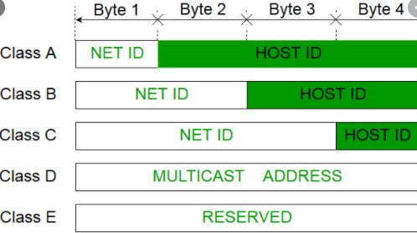

Slide 13

Finding the classes in binary and dotted-decimal notation
19.<number>
Notes:
In the Internet Protocol Version 4, the address 0.0. 0.0 is a non-routable meta-address used to designate an invalid, unknown or non-applicable target. This address is assigned specific meanings in a number of contexts, such as on clients or on servers.
In the context of servers, 0.0.0.0 can mean "all IPv4 addresses on the local machine". If a host has two IP addresses, 192.168.1.1 and 10.1.2.1, and a server running on the host is configured to listen on 0.0.0.0, it will be reachable at both of those IP addresses.
In the context of routing tables, a network destination of 0.0.0.0 is used with a network mask of 0 to depict the default route as a destination subnet. This destination is expressed as "0.0.0.0/0" in CIDR notation. It matches all addresses in the IPv4 address space and is present on most hosts, directed towards a local router.
In routing tables, 0.0.0.0 can also appear in the gateway column. This indicates that the gateway to reach the corresponding destination subnet is unspecified. This generally means that no intermediate routing hops are necessary because the system is directly connected to the destination.^{[4]}

Slide 14
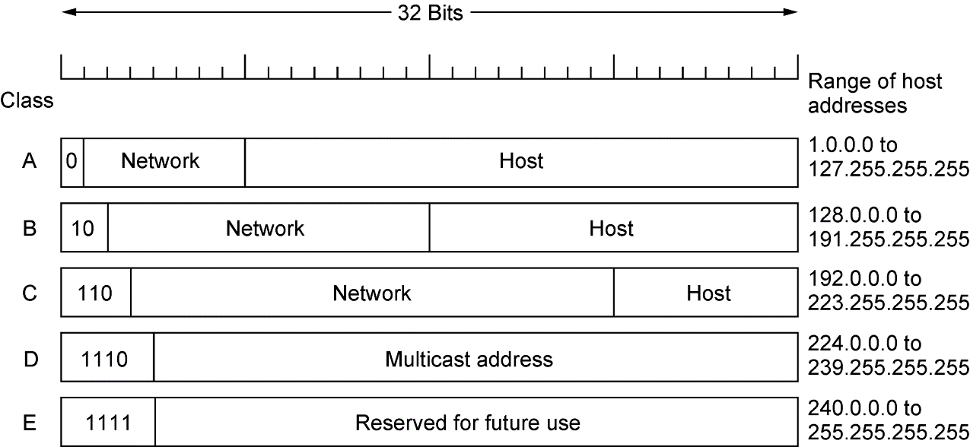
Classful addressing
Class A – Prefix – 8 bits
Starts with 0
Class B – Prefix – 16 bits
Starts with 10
Class C – Prefix – 24 bits
Starts with 110
Class D -Starts with 1110
28 bit Multicast address
Class E – Starts with 1111
Reserved
TCP IP Protocol Suite - Behrouz A. Forouzan
Notes:
A special definition exists for the IP address 255.255. 255.255. It is the broadcast address of the zero network or 0.0. 0.0, which in Internet Protocol standards stands for this network, i.e. the local network.
https://ideaspring.wordpress.com/2015/06/03/the-story-about-the-strange-ip-address-0-0-0-0-0-255-255-255/

Slide 15
Example 3
19.<number>
Find the class of each address.
a. 00000001 00001011 00001011 11101111
b. 11000001 10000011 00011011 11111111
c. 14.23.120.8
d. 252.5.15.111
Solution
a. The first bit is 0. This is a class A address.
b. The first 2 bits are 1; the third bit is 0. This is a class C
address.
c. The first byte is 14; the class is A.
d. The first byte is 252; the class is E.

Slide 16
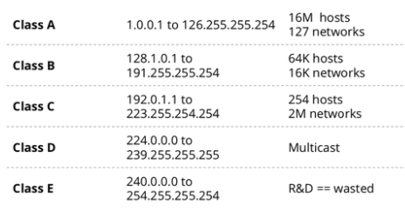
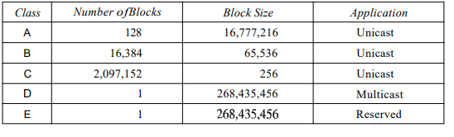
Number of networks and Hosts in classful IPv4 addressing
19.<number>
Block size is the sum of network address,
valid host addresses and broadcast address.
For example, if in a network there are
6 valid hosts than block size of that network is 8
(1 network address + 6 valid hosts + 1 broadcast address).
https://www.computernetworkingnotes.com/
ccna-study-guide/subnetting-tricks-
subnetting-made-easy-with-examples.html

Slide 17
19.<number>
Note
In classful addressing, a large part of the available addresses were wasted.

Slide 18

19.<number>
Default masks for classful addressing
Notes:
What is mask in IP address?
A subnet mask is a number that defines a range of IP addresses available within a network. A single subnet mask limits the number of valid IPs for a specific network. Multiple subnet masks can organize a single network into smaller networks (called subnetworks or subnets).
Although the length of the netid and hostid (in bits) is predetermined in classful addressing, we can also use a mask (also called the default mask), a 32-bit number made of contiguous Is followed by contiguous 0s.

Slide 19
19.<number>
Note
Classful addressing, which is almost obsolete, is replaced with classless addressing.
Notes:
Classless Addressing-
To overcome address depletion and give more organizations access to the Internet, classless addressing was designed and implemented. In this scheme, there are no classes, but the addresses are still granted in blocks.
Classless Addressing is an improved IP Addressing system.
It makes the allocation of IP Addresses more efficient.
It replaces the older classful addressing system based on classes.
It is also known as Classless Inter Domain Routing (CIDR).
CIDR Block-
When a user asks for specific number of IP Addresses,
CIDR dynamically assigns a block of IP Addresses based on certain rules.
This block contains the required number of IP Addresses as demanded by the user.
This block of IP Addresses is called as a CIDR block.
Rules For Creating CIDR Block-
A CIDR block is created based on the following 3 rules-
Rule-01:
All the IP Addresses in the CIDR block must be contiguous.
Rule-02:
The size of the block must be presentable as power of 2.
Size of the block is the total number of IP Addresses contained in the block.
Size of any CIDR block will always be in the form 2¹, 2², 2³, 2⁴, 2⁵ and so on.
Rule-03:
First IP Address of the block must be divisible by the size of the block.
REMEMBER
If any binary pattern consisting of (m + n) bits is divided by 2^{n}, then-
Remainder is least significant n bits
Quotient is most significant m bits
So, any binary pattern is divisible by 2^{n}, if and only if its least significant n bits are 0.
Examples-
Consider a binary pattern-
01100100.00000001.00000010.01000000
(represented as 100.1.2.64)
It is divisible by 2⁵ since its least significant 5 bits are zero.
It is divisible by 2⁶ since its least significant 6 bits are zero.
It is not divisible by 2⁷ since its least significant 7 bits are not zero.
CIDR Notation-
CIDR IP Addresses look like-
a.b.c.d / n
They end with a slash followed by a number called as IP network prefix.
IP network prefix tells the number of bits used for the identification of network.
Remaining bits are used for the identification of hosts in the network.
Example-
An example of CIDR IP Address is-
182.0.1.2 / 28
It suggests-
28 bits are used for the identification of network.
Remaining 4 bits are used for the identification of hosts in the network.
PRACTICE PROBLEMS BASED ON CLASSLESS INTER DOMAIN ROUTING-
Problem-01:
Given the CIDR representation 20.10.30.35 / 27. Find the range of IP Addresses in the CIDR block.
Solution-
Given CIDR representation is 20.10.30.35 / 27.
It suggests-
27 bits are used for the identification of network.
Remaining 5 bits are used for the identification of hosts in the network.
Given CIDR IP Address may be represented as-
00010100.00001010.00011110.00100011 / 27
So,
First IP Address = 00010100.00001010.00011110.00100000 = 20.10.30.32
Last IP Address = 00010100.00001010.00011110.00111111 = 20.10.30.63
Thus, Range of IP Addresses = [ 20.10.30.32 , 20.10.30.63]
Problem-02:

Slide 20
Classless Addressing-
Classless Addressing is an improved IP Addressing system.
It makes the allocation of IP Addresses more efficient.
It replaces the older classful addressing system based on classes.
It is also known as Classless Inter Domain Routing (CIDR).
CIDR Block-
When a user asks for specific number of IP Addresses,
CIDR dynamically assigns a block of IP Addresses based on
certain rules.
This block contains the required number of IP Addresses as demanded by the user.
This block of IP Addresses is called as a CIDR block.
19.<number>
https://www.gatevidyalay.com/

Slide 21
Rules For Creating CIDR Block-
A CIDR block is created based on the following 3 rules-
Rule-01:
All the IP Addresses in the CIDR block must be contiguous.
Rule-02:
The size of the block must be presentable as power of 2.
Size of the block is the total number of IP Addresses contained in the block.
Size of any CIDR block will always be in the form 2¹, 2², 2³, 2⁴,
2⁵ and so on.
Rule-03:
First IP Address of the block must be divisible by the size of the block.
If any binary pattern consisting of (m + n) bits is divided by 2^{n}, then-
    Remainder is least significant n bits
    Quotient is most significant m bits
So, any binary pattern is divisible by 2^{n}, if and only if its least significant n bits are 0.
19.<number>
Notes:
REMEMBER
If any binary pattern consisting of (m + n) bits is divided by 2^{n}, then-
Remainder is least significant n bits
Quotient is most significant m bits
So, any binary pattern is divisible by 2^{n}, if and only if its least significant n bits are 0.

Slide 22
19.<number>
Example 4-( First IP Address of the block must be divisible by the size of the block).
Consider a binary pattern- 01100100.00000001.00000010.01000000
(represented as 100.1.2.64)
It is divisible by 2⁵ since its least significant 5 bits are zero.
It is divisible by 2⁶ since its least significant 6 bits are zero.
It is not divisible by 2⁷ since its least significant 7 bits are not zero.
CIDR Notation-
CIDR IP Addresses look like- a.b.c.d / n
They end with a slash followed by a number called as IP network prefix.
IP network prefix tells the number of bits used for the identification of network.
Remaining bits are used for the identification of hosts in the network.

Slide 23
19.<number>
Example 5:
An example of CIDR IP Address is- 182.0.1.2 / 28
It suggests-
28 bits are used for the identification of network.
Remaining 4 bits are used for the identification of hosts in the network.

Slide 24

A block of 16 addresses granted to a small organization
19.<number>

Slide 25
19.<number>
Note
In IPv4 addressing, a block of
addresses can be defined as
x.y.z.t /n
in which x.y.z.t defines one of the addresses and the /n defines the mask.

Slide 26
19.<number>
Note
The first address in the block can be found by setting the rightmost
32 − n bits to 0s.

Slide 27
Example 6
19.<number>
A block of addresses is granted to a small organization. We know that one of the addresses is 205.16.37.39/28. What is the first address in the block?
Solution
The binary representation of the given address is
11001101 00010000 00100101 00100111
If we set 32−28 rightmost bits to 0, we get
11001101 00010000 00100101 0010000
or
205.16.37.32.

Slide 28
19.<number>
Note
The last address in the block can be found by setting the rightmost
32 − n bits to 1s.

Slide 29
Example 7:
19.<number>
Find the last address for the block given in the previous example.
Solution
The binary representation of the given address is
11001101 00010000 00100101 00100111
If we set 32 − 28 rightmost bits to 1, we get
11001101 00010000 00100101 00101111
or
205.16.37.47

Slide 30
19.<number>
Note
The number of addresses in the block can be found by using the formula
2^{32−n}.

Slide 31
Example 8
19.<number>
Find the number of addresses (same example).
Solution
The value of n is 28, which means that number
of addresses is 2 ³²⁻²⁸ or 16.

Slide 32
19.<number>
Example 9:
Given the CIDR representation 20.10.30.35 / 27. Find the range of IP Addresses in the CIDR block.
Solution-
Given CIDR representation is 20.10.30.35 / 27.
It suggests-
27 bits are used for the identification of network. Remaining 5 bits are used for the identification of hosts in the network. Given CIDR IP Address may be represented as- 00010100.00001010.00011110.00100011 / 27
So,
First IP Address = 00010100.00001010.00011110.00100000 = 20.10.30.32
Last IP Address = 00010100.00001010.00011110.00111111 = 20.10.30.63
Thus, Range of IP Addresses = [ 20.10.30.32 , 20.10.30.63]

Slide 33
Example 10
19.<number>
Another way to find the first address, the last address, and the number of addresses is to represent the mask as a 32-bit binary (or 8-digit hexadecimal) number. This is particularly useful when we are writing a program to find these pieces of information. In Example 19.5 the /28 can be represented as
11111111 11111111 11111111 11110000
(twenty-eight 1s and four 0s).
Find
a. The first address
b. The last address
c. The number of addresses.

Slide 34

19.<number>
Solution
a. The first address can be found by ANDing the given
addresses with the mask. ANDing here is done bit by
bit. The result of ANDing 2 bits is 1 if both bits are 1s;
the result is 0 otherwise.

Slide 35

19.<number>
The last address can be found by ORing the given
addresses with the complement of the mask. ORing
here is done bit by bit. The result of ORing 2 bits is 0 if
both bits are 0s; the result is 1 otherwise. The
complement of a number is found by changing each 1
to 0 and each 0 to 1.

Slide 36
19.<number>
The number of addresses can be found by
complementing the mask, interpreting it as a decimal
number, and adding 1 to it.

Slide 37
A network configuration for the block 205.16.37.32/28
19.<number>

Slide 38
19.<number>
Note
The first address in a block is
normally not assigned to any device;
it is used as the network address that represents the organization
to the rest of the world.

Slide 39

Two levels of hierarchy in an IPv4 address
19.<number>

Slide 40

A frame in a character-oriented protocol
19.<number>
Two-Level Hierarchy: No Subnetting
Notes:
Two-Level Hierarchy: No Subnetting
An IP address can define only two levels of hierarchy when not subnetted. The n leftmost bits of the address x.y.z.t/n define the network (organization network); the 32 - n rightmost bits define the particular host (computer or router) to the network. The two common terms are prefix and suffix. The part of the address that defines the network is called the prefix; the part that defines the host is called the suffix.

Slide 41
19.<number>
Note
Each address in the block can be considered as a two-level
hierarchical structure:
the leftmost n bits (prefix) define
the network;
the rightmost 32 − n bits define
the host.

Slide 42

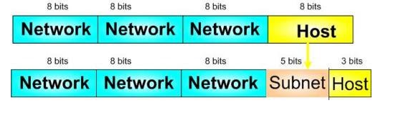
Three-level hierarchy in an IPv4 address
19.<number>
Notes:
To better understand the concept of subnetting, imagine a network with a total of 256 addresses (a Class C network). One of these addresses is used to identify the network address and another one is used to identify the broadcast address on the network. Therefore, we are left with 254 addresses available for addressing hosts.
If we take all these addresses and divide them equally into 8 different subnets we still keep the total number of original addresses, but we have now split them into 8 subnets with 32 addresses in each. Each new subnet needs to dedicate 2 addresses for the subnet and broadcast address within the subnet.
The result is that we eventually come up with 8 subnets, each one possessing 30 subnet addresses available for hosts. You can see that the total amount of addressable hosts is reduced (240 instead of 254) but better management of addressing space is gained.
Now that we have subnet mask explained, I'll now use a couple of examples to help explain how an IP address subnet mask can be calculated as clearly as possible, but first, here is a quick explanation of “What is a subnet mask?” An IP subnet mask is a number used for defining a range of IP addresses that are available within a network.

Slide 43
19.<number>
Subnetting
In networking,
The process of dividing a single network into multiple sub networks
is called as subnetting.
The sub networks so created are called as subnets.
https://www.computernetworkingnotes.com/ccna-study-guide/
basic-subnetting-in-computer-networks-explained.html

Slide 44
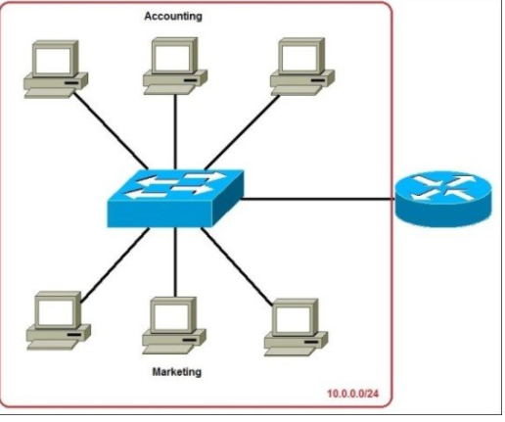
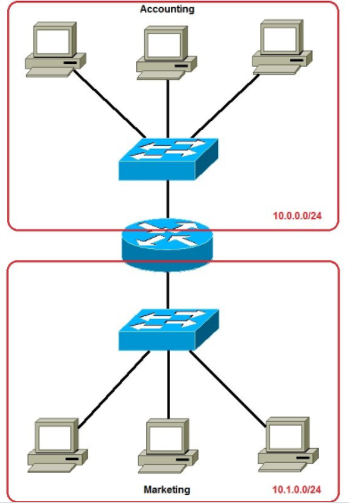
19.<number>
Before subnetting
After subnetting
Notes:
In the picture above we have one huge network: 10.0.0.0/24. All hosts on the network are in the same subnet, which has the following disadvantages:
a single broadcast domain – all hosts are in the same broadcast domain. A broadcast sent by any device on the network will be processed by all hosts, creating lots of unnecessary traffic.
network security – each device can reach any other device on the network, which can present security problems. For example, a server containing sensitive information shouldn’t be in the same network as user’s workstations.
organizational problems – in a large networks, different departments are usually grouped into different subnets. For example, you can group all devices from the Accounting department in the same subnet and then give access to sensitive financial data only to hosts from that subnet.

Slide 45
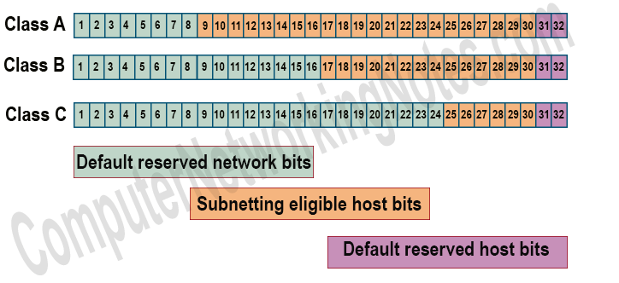
19.<number>
https://www.computernetworkingnotes.com/ccna-study-guide/
basic-subnetting-in-computer-networks-explained.html

Slide 46
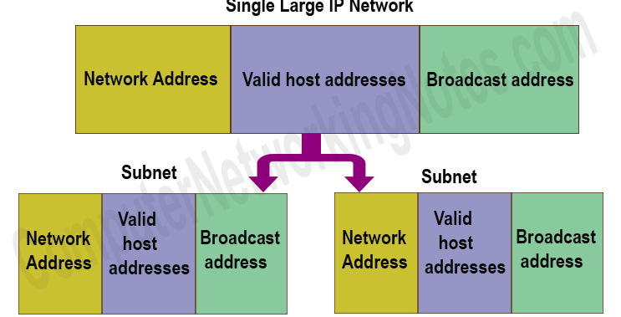
19.<number>
Valid host addresses
All addresses between Network address and Broadcast address are known as valid host addresses.(8-2)
Block Size(total hosts)
Block size is the sum of network address, valid host addresses and broadcast address. For example, if in a network there are 6 valid hosts than block size of that network is 8 (1 network address + 6 valid hosts + 1 broadcast address).
https://www.computernetworkingnotes.com/ccna-study-guide/
basic-subnetting-in-computer-networks-explained.html

Slide 47

19.<number>
How many bits we need to set up the subnet?
A combination of all 32 represents a unique IP address.
A combination of network bits in IP address represents the number of networks or subnets.
A combination of host bits in IP address represents the number of total hosts.
For example, to break a single large network in 4 subnets, we need 2 (2² = 4) Subnetting bits. This way if we have 3 Subnetting bits, we can make 8 (2³ = 8) additional networks.
Subnetting Direction
A class C network is subnetted in 4 subnets. Find the number of host bits used in Subnetting and their location in address space.
To create 4 subnets we need to 2 (2² = 4) Subnetting eligible host bits (25th and 26th bits).

Slide 48
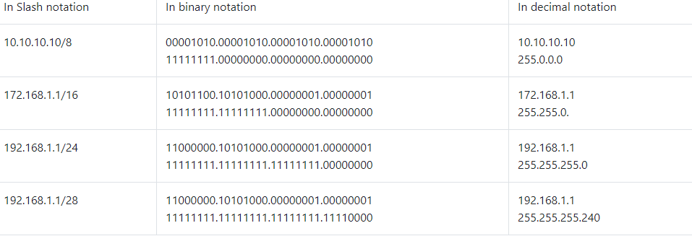
19.<number>
Slash Notation
It’s a compact representation of Subnet mask.
In this notation a slash (/) sign and total number of the on bits in subnet mask are written with IP address instead of full Subnet mask.

Slide 49
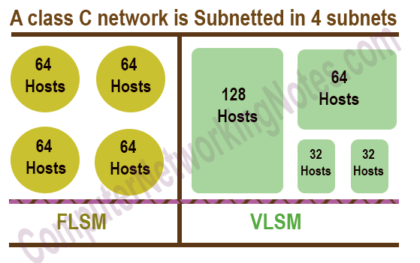
Types of Subnetting
19.<number>
Two types of Subnetting FLSM (Fixed Length Subnet Masks)and
VLSM(Variable Length Subnet Masks).
    In FLSM, all subnets have equal number of host addresses and
    _{use same Subnet mask.}
    In VLSM, subnets have flexible number of host addresses
    _{and use different subnet mask.}
FLSM:Default mask: 11111111.11111111.11111111.11000000

Slide 50
19.<number>
FLSM (Fixed Length Subnet Mask)
consider an IP address 198.168.10.0
Now we have to divide this IP address into 4 subnetwork parts.
After dividing we have to find out the range of IP addresses blocks.
Steps:
Step 1: Calculate the required subnet bit.
In this subnetting process, we will borrow the bit from the host side.
11111111.11111111.11111111.11000000
Step 2: In this step we will be calculating updated subnet mask.
255.255.255.192
Step 3: We will find the range in this step.
Range: (Maximum Subnet Mask – Updated Subnet Mask)
255.255.255.255 - 255.255.255.192 = 0. 0. 0. 63

Slide 51
19.<number>
Step 4: Now we will divide the whole network with the help of the range.
First Network Block: 198.168.10.0 – 198.168.10.63
For this block Network ID will be 198.168.10.0 and Broadcast address will be 198.168.10.63
Second Network Block:198.168.10.64 – 198.168.10.127
For this block Network ID will be 198.168.10.64 and Broadcast address will be 198.168.10.127
Third Network Block: 198.168.10.128 – 198.168.10.191
For this block Network ID will be 198.168.10.128 and Broadcast address will be 198.168.10.191
Fourth Network Block:198.168.10.192 – 198.168.10.255
For this block Network ID will be 198.168.10.192 and Broadcast address will be 198.168.10.255
Subnet masks will remain same for every network block i.e. 255.255.255.192

Slide 52

VLSM(Variable Length Subnet Mask)
19.<number>
Example:
Let’s take the same IP address 198.168.10.0. configure such a network in such a way that given network able to provide 50 IP addresses and 20 IP addresses.
Step 1: Calculate host bit.
  For the first case it is given 50 IP addresses is required but 1 IP is required for Network address and another is for Broadcast address. So total requirement is 50+2=52 IP addresses.
From here we can get that 6 Host bit is required,
Host bit = 6

Slide 53
19.<number>
Step 2: Find out Network bit with the help of the given formula
Network bit= (32 – Host bit)
In this case Network bit = 32 – 6 =26
Step 3: Calculate updated subnet mask
  As we all know network bit is represented by 1 and Host bit is represented by 0.
  Now we have the updated subnet mask:
  11111111.11111111.11111111.11000000
  _{255.255.255.192}
  Now, we will find the range using the formula which we have used in FLSM,
  _{i.e.}
  Range = Maximum Subnet Mask – Updated Subnet Mask
  Then we will get the final Range
  255.255.255.255 - 255.255.255.192 = 0. 0. 0. 63
  Network Block for the 50 IP addresses is 198.168.10.0 to 198.168.10.63

Slide 54

Again, for 20 IP addresses we have to follow same 3 steps.
Total IP required = 20+2=22
Step 1:
Host Bit = 5
Step 2: Now, Network Bit= 32 – 5= 27
Step 3: Updated mask
    _{Network Bit = 1 ,Host Bit =0}
    11111111.11111111.11111111.11100000
    _{255.255.255.224}
    Updated Mask Value = 255.255.255.224
    _{Range is 0.0.0.31}
    Network Block for 22 IP addresses is from
    _{198.168.10.64 to 198.168.10.95}
19.<number>

Slide 55
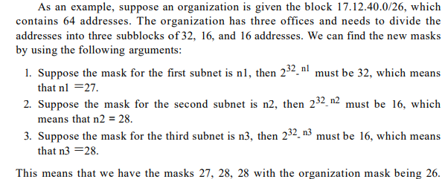
19.<number>

Slide 56
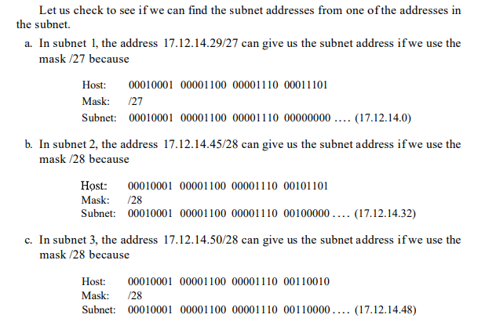
19.<number>

Slide 57

Configuration and addresses in a subnetted network
19.<number>
Notes:
Subnetting is the practice of dividing a network into two or more smaller networks. It increases routing efficiency, enhances the security of the network and reduces the size of the broadcast domain.
If an organization was granted a large block in class A or B, it could divide the addresses into several contiguous groups and assign each group to smaller networks (called subnets) or, in rare cases, share part of the addresses with neighbors.
IP Subnetting is a process of dividing a large IP network in smaller IP networks. In Subnetting we create multiple small manageable networks from a single large IP network.
Let’s take an example.
To best utilize available addresses if we put more than 16000000 hosts in a single network, due to broadcast and collision, that network will never work. If we put less hosts then remaining addresses will be wasted.
Subnetting provides a better way to deal with this situation. Subnetting allows us to create smaller networks from a single large network which not only fulfill our hosts’ requirement but also offer several other networking benefits.
I have already explained the advantages of Subnetting along with why Subnetting is necessary in previous parts of this tutorial. In this part, I will mainly focus on Subnetting components and terminology.

Slide 58
Example 19.10
19.<number>
An ISP is granted a block of addresses starting with 190.100.0.0/16 (65,536 addresses). The ISP needs to distribute these addresses to three groups of customers as follows:
a. The first group has 64 customers; each needs 256
addresses.
b. The second group has 128 customers; each needs 128
addresses.
c. The third group has 128 customers; each needs 64
addresses.
Design the subblocks and find out how many addresses are still available after these allocations.

Slide 59

Example 19.10 (continued)
19.<number>
Solution
Figure 19.9 shows the situation.
Group 1
For this group, each customer needs 256 addresses. This means that 8 (log2 256) bits are needed to define each host. The prefix length(Mask) is then 32 − 8 = 24. The addresses are

Slide 60

Example 19.10 (continued)
19.<number>
Group 2
For this group, each customer needs 128 addresses. This means that 7 (log2 128) bits are needed to define each host. The prefix length is then 32 − 7 = 25. The addresses are

Slide 61

Example 19.10 (continued)
19.<number>
Group 3
For this group, each customer needs 64 addresses. This means that 6 (log₂64) bits are needed to each host. The prefix length is then 32 − 6 = 26. The addresses are
Number of granted addresses to the ISP: 65,536
Number of allocated addresses by the ISP: 40,960
Number of available addresses: 24,576

Slide 62

Figure 19.9 An example of address allocation and distribution by an ISP
19.<number>

Slide 63


How to Subnet a Class C Address Using the Binary Method
Let's use IP address 192.168.10.44 with subnet mask 255.255.255.248 or /29.
STEP 1: Convert to Binary
19.<number>
STEP 2: Calculate the Subnet Address
To calculate the IP Address Subnet you need to perform a bit-wise AND operation (1+1=1, 1+0 or 0+1 =0, 0+0=0) on the host IP address and subnet mask. The result is the subnet address in which the host is situated.
https://www.pluralsight.com/blog/it-ops/simplify-routing-how-to-organize-your-network-into-smaller-subnets
Notes:
How to Subset a Class C Address Using the Binary Method
It can be helpful to know how to be your own subnet mask calculator. Subset a Class C address with the binary method by following these four steps (which will be explained in more detail below):
Convert to binary.
Calculate the subset address.
Find host range.
Calculate the total number of subsets and the hosts per subnet.
We will use a Class C address, which takes 5 bits from the Host field for subnetting and leaves 3 bits for defining hosts as shown in figure 1 below. Having 5 bits available for defining subnets means that we can have up to 32 (2^5) different subnets.
It should be noted that in the past using subnet zero (00000---) and all-ones subnet (11111---) was not allowed. This is not true nowadays. Since Cisco IOS Software Release 12.0 the entire address space including all possible subnets is explicitly allowed.

Slide 64
STEP 3: Find Host Range
We know already that for subnetting this Class C address we have borrowed 5 bits from the Host field. These 5 bits are used to identify the subnets. The remaining 3 bits are used for defining hosts within a particular subnet.
The Subnet address is identified by all 0 bits in the Host part of the address. The first host within the subnet is identified by all 0s and a 1. The last host is identified by all 1s and a 0. The broadcast address is the all 1s. Now, we move to the next subnet and the process is repeated the same way.
The following diagram clearly illustrates this process:
19.<number>

Slide 65
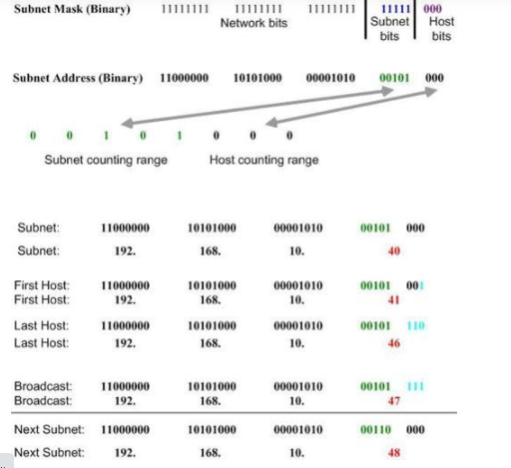
19.<number>

Slide 66
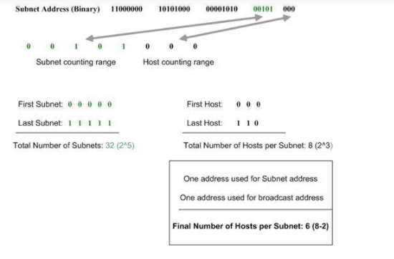
19.<number>
STEP 4: Calculate the Total Number of Subnets and Hosts Per Subnet
Knowing the number of Subnet and Host bits we can now calculate the total number of possible subnets and the total number of hosts per subnet. We assume in our calculations that all-zeros and all-ones subnets can be used. The following diagram illustrates the calculation steps.

Slide 67
Network address Translation - NAT
Network address translation (NAT) is a method of remapping an
IP address space into another by modifying network address
information in the IP header of packets while they are in
transit across a traffic routing device.
The technique was originally used to avoid the need
to assign a new address to every host when a network
was moved.
The ISP may not be able to grant the demand
Because the addresses before and after the range may have already been allocated to other networks
The distribution of addresses through ISPs has created a new problem.
If the business grows or
The household needs a larger range
In most situations, however, only a portion of computers in a small network need access to the Internet simultaneously.

Slide 68

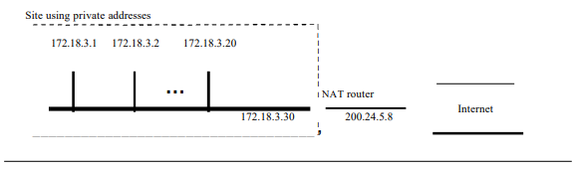
Addresses for private networks
19.<number>

Slide 69
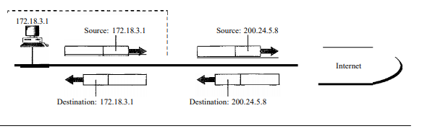
NAT
A technology that can help in these cases is NAT
    _{Address Translation}
    _{Translation Table}
    _{Private IP address}
    _{Routable IP address}
TCP IP Protocol Suite - Behrouz A. Forouzan

Slide 70
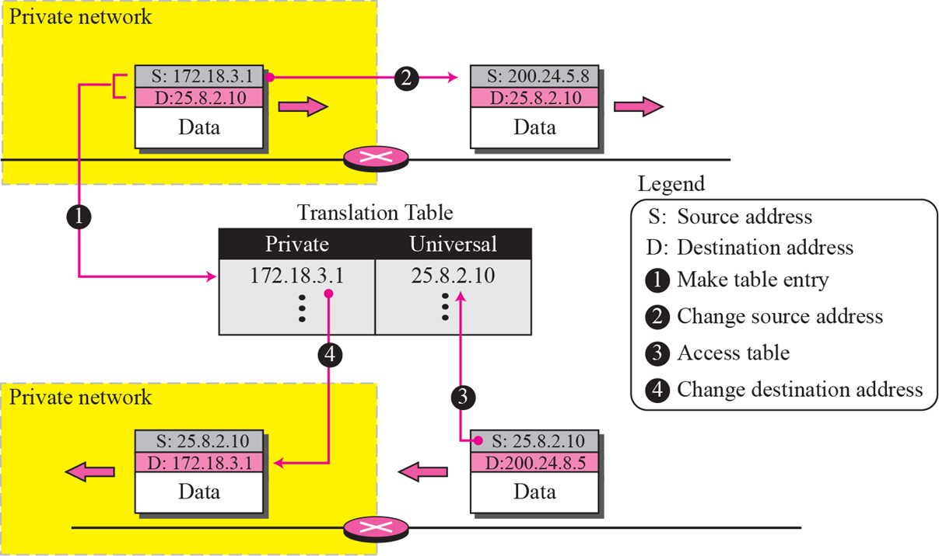
NAT
A technology that can help in these cases is NAT
    _{Address Translation}
    _{Translation Table}
TCP IP Protocol Suite - Behrouz A. Forouzan

Slide 71
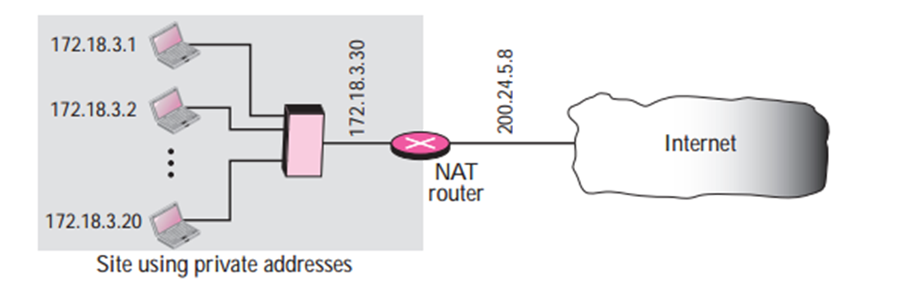
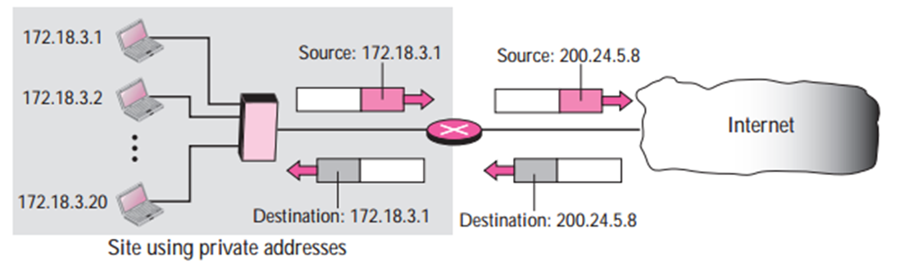
Network address Translation - NAT
Private IP address
172.18.x.y
Routable IP address
200.24.5.8

Slide 72
Special IP address
Private address
10.0.0.0/8 - 10.255.255.255
172.16.0.0/12 - 172.16.15.255
192.168.0.0/16 – 192.168.255.255
169.254.0.0/16- 169.254. 255.255
How many addresses in each private address?
What is the last address?

Slide 73
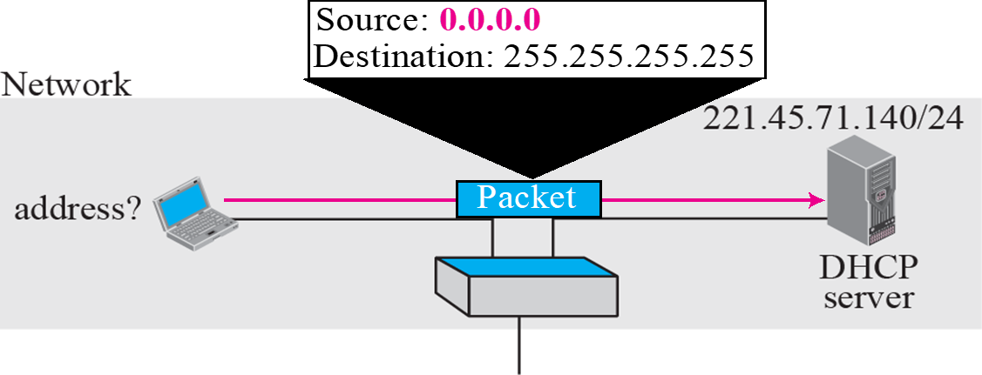
Special IP address
0.0.0.0/32
  Used when I do not know my IP address
  _{Bootstrap server}
  _{DHCP server}
127.0.0.0
  _{Loop back address}
  Software testing – IPv4, Client-server
Source 0.0.0.0
Destination 255.255.255.255
TCP IP Protocol Suite - Behrouz A. Forouzan

Slide 74
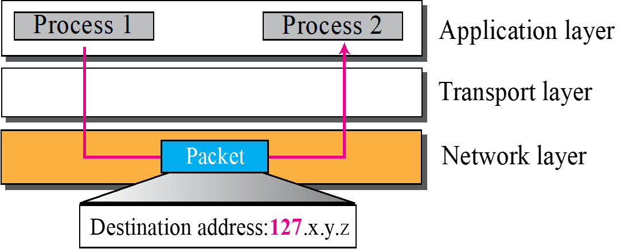
Special IP address
0.0.0.0/32
  Used when I do not know my IP address
  _{Bootstrap server}
  _{DHCP client}
127.0.0.1
  _{Loop back address}
  Software testing – IPv4, Client-server
Dst Addr 127.0.0.0
TCP IP Protocol Suite - Behrouz A. Forouzan

Slide 75
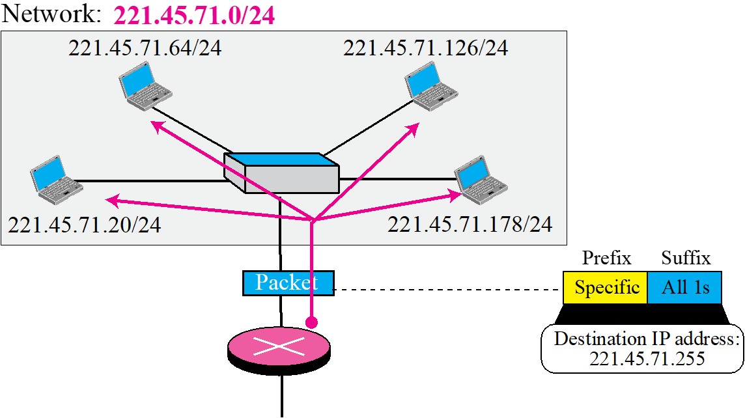
Special IP address
Network address – First address
    _{All suffix set to zero}
    _{20.12.14.0/24}
Last address
  _{Direct broadcast address}
    _{All suffix set to one}
    _{20.12.14.255/24}
TCP IP Protocol Suite - Behrouz A. Forouzan

Slide 76
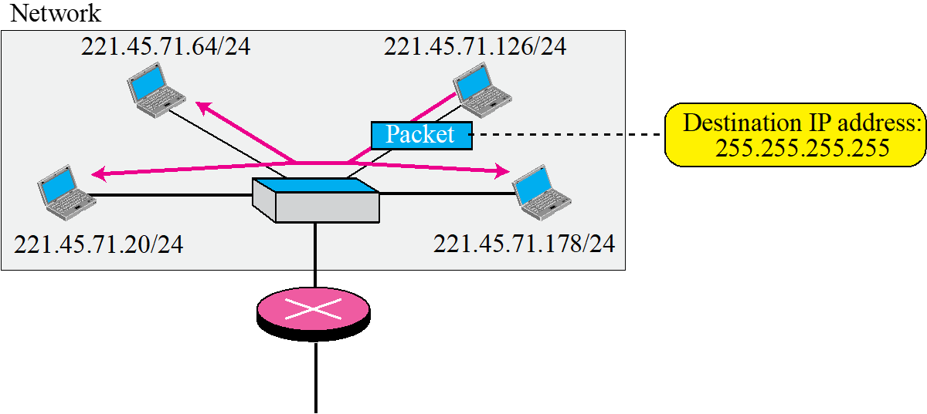
Special IP address
Limited broadcast address
  _{255.255.255.255}
TCP IP Protocol Suite - Behrouz A. Forouzan

